Slide 1

Notes:
This should be the title slide for all corporate presentations pertaining to the overall university level

Slide 2

Faculty of Engineering And Technology
Department of Artificial Intelligence and Data Science
Notes:
This is the title slide for respective colleges/institutions while we retain the DMIHER logo on top always.

Slide 3

Presentation for Major Project-II

Slide 4
PRESENTATION FOR MAJOR PROJECT
TOPIC Breast Cancer Classification Using
Deep Learning: A GUI-Based Approach
NAME OF STUDENT: SANIKA SUDHIR BELSARE.
NAME OF THE SUPERVISOR: DR. ASHUTOSH BAGDE
ROLL NO.: DMET1221012
DEPARTMENT OF ARTIFICIAL INTELLIGENCE AND DATA SCIENCE,
FACULTY OF ENGINEERING AND TECHNOLOGY, SAWANGI (MEGHE), WARDHA
DATE: 28-02-2025

Slide 5
CONTENTS
Introduction
Prisma Chart
Prisma-S Extension
Knowledge /Research gap analysis
Knowledge/Research Gap Summary
Nature of the Knowledge Gap Identified
Research Question
Aim
Objectives
Methodology

Slide 6
CONTENTS
Flowchart
Quarterly Scheduling of Research Work
Publication Schedule
References

Slide 7
INTRODUCTION
Breast cancer remains one of the leading causes of cancer-related deaths among women worldwide.
Early detection is crucial for improving survival rates and treatment effectiveness.
Traditional diagnostic methods, such as mammograms and biopsies, rely heavily on medical expertise and can sometimes be prone to errors.
To address these challenges, deep learning has emerged as a powerful tool for medical image analysis, offering more accurate and efficient results.
This project, “Breast Cancer Classification using Deep Learning: A GUI-Based Approach," leverages the power of the ResNet50, VGG16, MobileNet deep learning algorithm, renowned for its high performance in image classification tasks.

Slide 8
INTRODUCTION
By comparing ResNet50, VGG16, and MobileNet, a convolutional neural network (CNN) architecture, the project aims to develop a more accurate model for classifying breast cancer images.
The model will be integrated with an interactive GUI built using Streamlit, allowing medical professionals to input data and receive classification results easily.
This approach seeks to make breast cancer detection more accessible, user-friendly, and reliable, ultimately contributing to earlier diagnosis and improved patient outcomes.

Slide 9
SYSTEMATIC REVIEW OF LITERATURE (PRISMA FLOW DIAGRAM)
Identification
Articles identified through other sources SCIE/SCOPUS/Research Gate Sources (n= 11)
Articles identify through IEEE searching (n= 20)
Records after duplicates removal (n=25)
Screening
Records screened for removal(n=25)
Article excluded:(n=6)
Records excluded(n=8)
Full-text articles were excluded for the following reasons: The objective does not match.
Number of Full text articles assessed for eligibility (n=19)
Eligibility
Original articles-4
Review articles-3
Included
Number of Studies included in Qualitative and Quantitative (n=7)

Slide 10
PRISMA-S EXTENSION
Topic | Item | Checklist item
Data base name | 1 | PubMed, IEEE, Elsevier, Research Gate, Google Scholar
Registries | 2 | N/A
MESH TERMS | 3 | Deep learning, Data analysis, python, ResNet50, VGG16, MobileNet, Image Processing
Search strategies | 4 | Mesh terms, Keywords, phrases, headlines, terms and citations are used as search strategies to gather the data
Selection process | 5 | Articles reporting on any one or more of the Deep learning methods for breast cancer disease classification
Limits and restrictions | 6 | Focus on studies conducted within the last 5 years. Older studies are included only for historical references.
Search filters | 7 | Studies that do not address the research question, incomplete abstracts, and studies with inadequate methodologies are filtered out.
Total records | 8 | Journal articles, Research articles. A total of 11 literature is part of the study.

Slide 11
RESEARCH ARTICLES INCLUDED
Sr. No | Type of article | Total
1 | Original Article | 4
2 | SR & MA | 0
3 | RCT | 0
4 | Review | 3
5 | Books | 0
Grand Total | Grand Total | 7

Slide 12
KNOWLEDGE GAP
S. No. | Title of the Article Author, Year of Publication | Focus of Study, Design, Method Used, and Sample Size | Findings of the study and their Conclusions | Scholar's Remarks on Limitations
1 | Comparative analysis of breast cancer detection using machine learning and biosensors Amethiya, Yash, et al. 2022 | Focus: Breast cancer detection using ML and biosensors. Design: Comparative analysis. Method: ML algorithms. Sample Size: 500 cases. | Findings: ML and biosensors improve detection efficiency. | Limitations: Lack of large-scale datasets.
2 | A fuzzy rule‐based system with decision tree for breast cancer detection Gupta, Vedika, et al 2023 | Focus: Breast cancer detection. Design: Fuzzy rule-based system. Method: Decision tree. Sample Size: 300 cases. | Findings: Enhanced accuracy in detection using hybrid approaches. | Limitations: Computational complexity.
3 | Breast Cancer Detection by using Supervised Learning Algorithm Abarna, B., & Rajesh, S. 2022 | Focus: Breast cancer detection. Design: Supervised learning. Method: ML algorithms. Sample Size: 200 cases. | Findings: Effective detection using supervised learning. | Limitations: Limited dataset size.

Slide 13
KNOWLEDGE GAP
S. No. | Title of the Article Author, Year of Publication | Focus of Study, Design, Method Used, and Sample Size | Findings of the study and their conclusions | Scholar's Remarks on Limitations
4 | Breast Cancer Detection Using Fuzzy C-Means and Artificial Bee Colony Optimization Sundaravadivelu, B., & Santhanakrishnan, K. 2023 | Focus: Segmentation and grading. Design: Fuzzy C-Means and optimization. Method: Random forest classifier. Sample Size: 250 cases. | Findings: Improved segmentation and grading accuracy. | Limitations: Complexity in implementation.
5 | Review of CAD systems for breast tumor classification using ultrasound Kriti, Virmani, J., & Agarwal, R. 2022 | Focus: CAD systems for breast tumor detection. Design: Review-based study. Method: Analysis of B-mode ultrasound. Sample Size: 150 systems reviewed. | Findings: High potential of CAD systems in ultrasound. | Limitations: Need for real-time implementation.
6 | Image processing for identification of breast cancer: A literature survey Delphina, A. A., et al. 2018 | Focus: Image processing methods. Design: Literature survey. Method: Image processing techniques. Sample Size: 50 studies reviewed | Findings: Overview of methods and their efficiency. | Limitations: Lacks experimental validation.

Slide 14
KNOWLEDGE GAP
S. No. | Title of the Article Author, year of Publication | Focus of Study, Design, Method Used, and Sample Size | Findings of the study and their conclusions | Findings, Conclusions, and Scholar's Remarks on Limitations
7 | ABT: A comparative analytical survey on Analysis of Breast Thermograms Ensafi, M., et al. 2024 | Focus: Breast thermograms. Design: Analytical survey. Method: Comparative analysis. Sample Size: 400 thermograms. | Findings: Insights into breast thermogram analysis techniques. | Limitations: Limited exploration of advanced methods.

Slide 15
KNOWLEDGE GAP SUMMARY
Dataset Limitations: Lack of large-scale and diverse datasets in many studies.
Computational Complexity: Real-time implementation remains a challenge.
Limited Exploration of Techniques: The study narrowly focused on specific methods, with insufficient exploration of emerging approaches like deep learning.
Integration Challenges: Mammogram analysis are not fully integrated with current DL-based detection systems
Real-Time Applications: Several methods require further development for effective real-time applications in clinical settings.

Slide 16
RESEARCH QUESTION
How can deep learning, ResNet50, VGG16, and MobileNet algorithms be used to classify breast cancer images accurately, and how can a user-friendly graphical interface (GUI) be designed to enable medical professionals to easily access and interpret the results for improved diagnosis and early detection?

Slide 17
AIM
To develop an interactive breast cancer classification system using comparative analysis in ResNet50, VGG16, and MobileNet deep learning algorithms, integrated with a user-friendly Graphical User Interface (GUI). The system will accurately classify breast cancer images into benign and malignant categories, providing medical professionals with reliable, AI-assisted diagnostic tools. The goal is to enhance early detection and improve diagnostic efficiency, making advanced technology accessible to healthcare providers without technical expertise.

Slide 18
OBJECTIVES
To extract the features from Mammographic images and create a CSV file.
To develop an accurate breast cancer classification model using the comparative analysis of ResNet50, VGG16, and MobileNet deep learning algorithms to distinguish between benign and malignant tumors based on medical images.
To design an interactive GUI to make the system accessible to medical professionals with minimal technical expertise.
To provide a practical tool that can be used by clinicians, researchers, and healthcare professionals to streamline breast cancer diagnosis and decision-making.
To integrate cutting-edge technology with a focus on usability, ensuring the solution is practical for real-world medical applications.
18

Slide 19
METHODOLOGY
Data Collection and Preprocessing:
Collect breast cancer image datasets, such as mammograms or histopathological images such as CBIS-DDSM.
Preprocess the images by resizing, normalizing, augmenting, and extracting the data to improve model robustness. This step includes data cleaning, removing irrelevant features, and transforming the images to a consistent format for input into the deep learning model.
Model Development using ResNet50, VGG16, MobileNet:
Implement the ResNet50, VGG16, MobileNet deep learning architecture, known for its high accuracy in image classification tasks. This model utilizes residual connections to help the network learn deep features more effectively.
Fine-tune the model by training it on the prepared dataset, adjusting hyperparameters such as learning rate, batch size, and number of epochs to optimize the model's performance.

Slide 20
METHODOLOGY
GUI Development with Streamlit:
Develop an interactive Graphical User Interface (GUI) using Streamlit, allowing users to upload breast cancer images and display the classification results.
The interface will present an easy-to-use platform for healthcare professionals to interact with the deep learning model without requiring technical knowledge.
Integration and Testing:
Integrate the trained VGG16 model with the Streamlit GUI for seamless interaction.
Perform extensive testing using a separate validation dataset to ensure the model’s performance is accurate and reliable in classifying new images.

Slide 21
METHODOLOGY
Deployment:
Deploy the application on a cloud platform for easy access and scalability.
Ensure the application is accessible to healthcare professionals across different regions, improving its practical use in medical diagnostics.
Evaluation and Performance Metrics:
Evaluate the model using common performance metrics such as accuracy, precision, recall, F1-score, and confusion matrix to assess the effectiveness of the classification.
Collect feedback from medical professionals to refine the GUI and ensure it meets user needs.

Slide 22
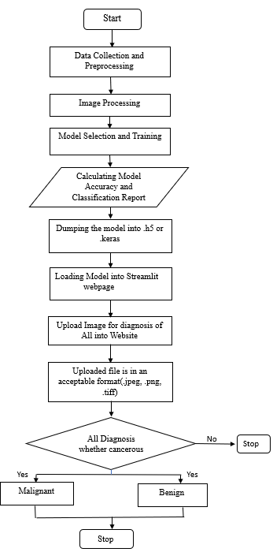
FLOWCHART

Slide 23
MATERIALS and METHOD
Materials
Data: Breast cancer image dataset (e.g., CBIS-DDSM dataset).
Software and Tools: Python, TensorFlow/Keras for deep learning, Streamlit for GUI, MongoDB for data storage, and VS Code for development.
Hardware: computer/laptop for development.
Method
Data Preprocessing: Resize and normalize images, apply data augmentation, extracting split the dataset into training, validation, and test sets.
Model Development: Implement the ResNet50, VGG16, and MobileNet models, fine-tune them using transfer learning for binary classification (benign vs malignant), and train them using an appropriate optimizer.
GUI Development: Build an intuitive Streamlit interface to upload images and display classification results.

Slide 24
MATERIALS and METHOD
Integration and Testing: Integrate the trained model with the GUI, then test and validate the system using a separate dataset.
Deployment: Deploy the application on a free cloud platform and store data in MongoDB.
Evaluation: Assess the model’s performance using metrics like accuracy, precision, and recall, and gather user feedback for improvements.

Slide 25
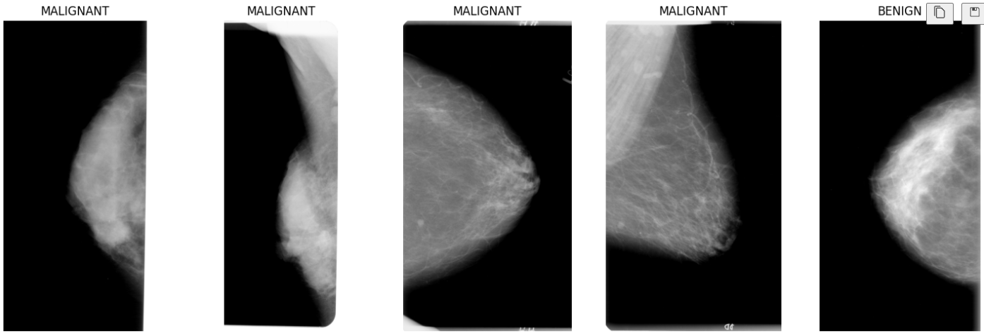
RESULTS
Dataset:

Slide 26
RESULTS
Accuracy and Loss of Models:
Model | Accuracy | Loss
ResNet50 | 0.8921 | 0.5927
MobileNet | 0.9770 | 0.0640
VGG16 | 0.9218 | 0.1998

Slide 27
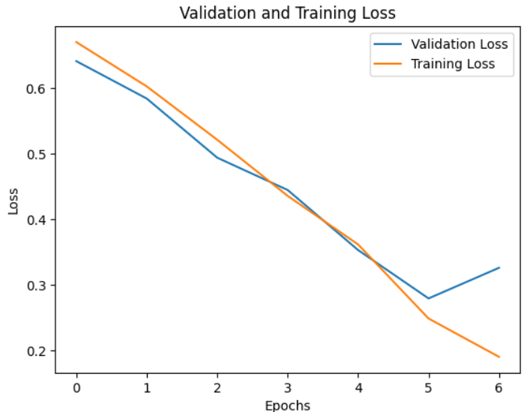
RESULTS
VGG16 Model :

Slide 28
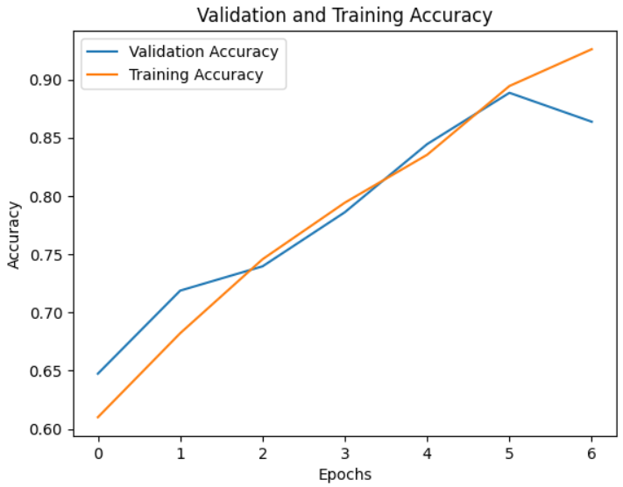
RESULTS

Slide 29
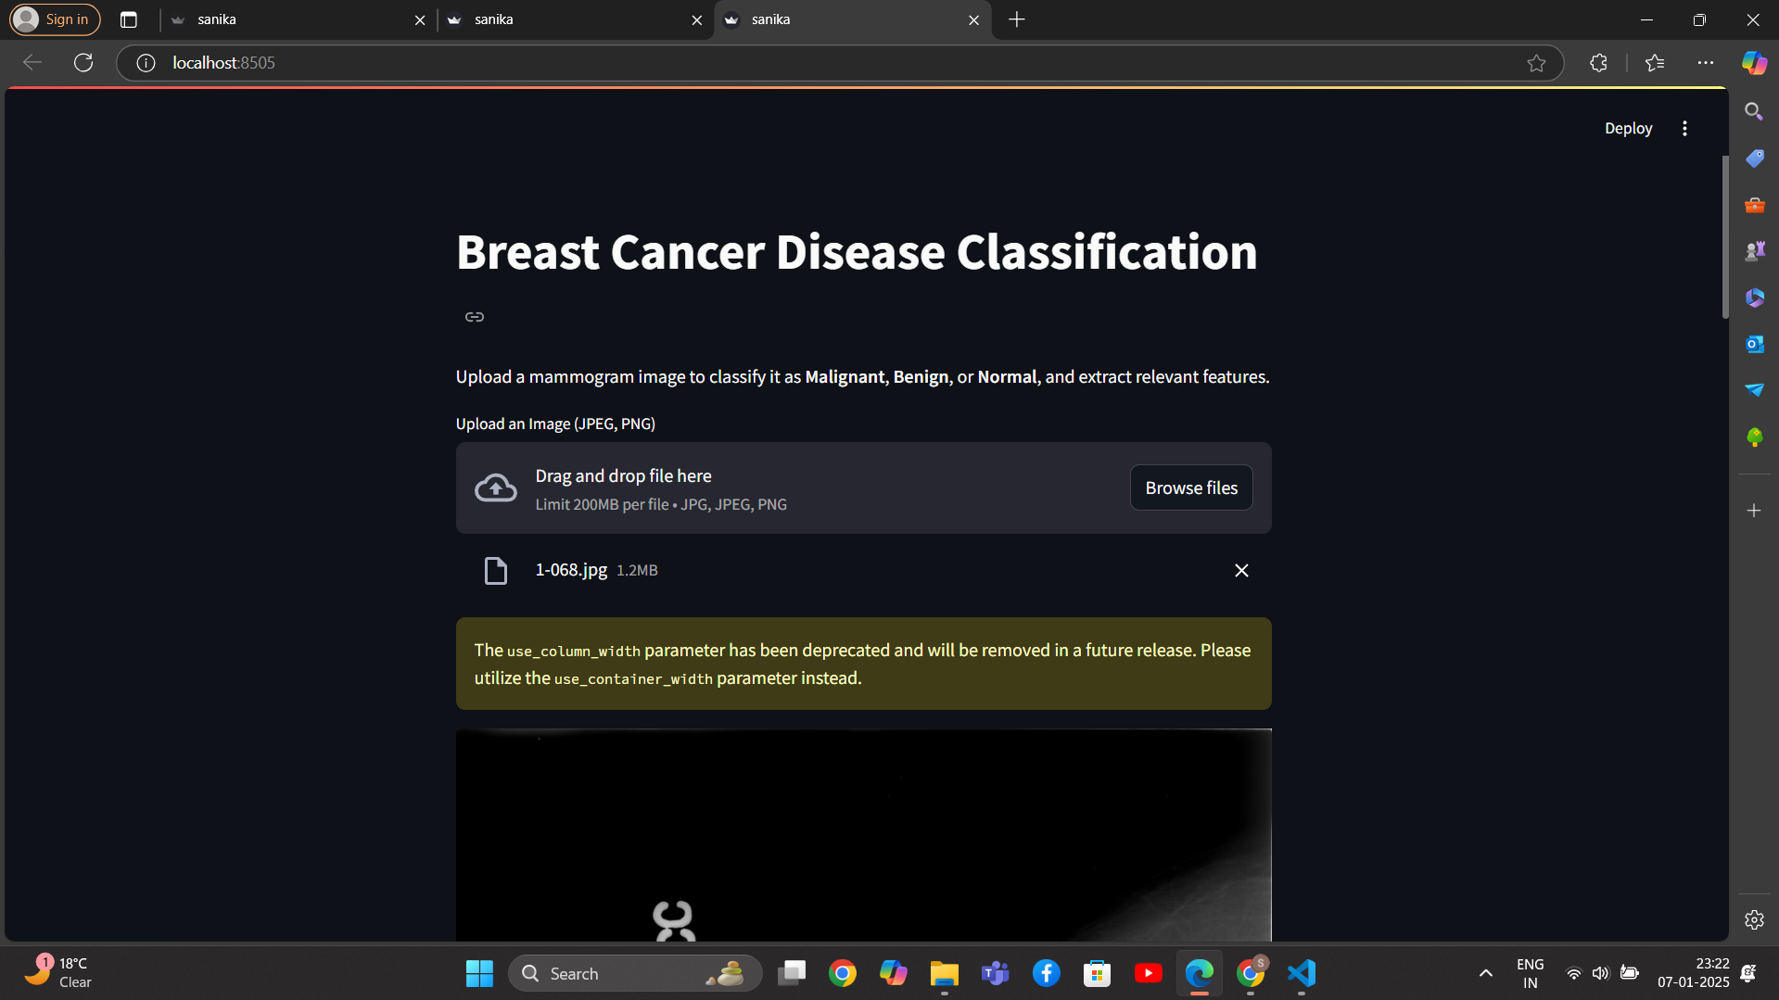
RESULTS

Slide 30
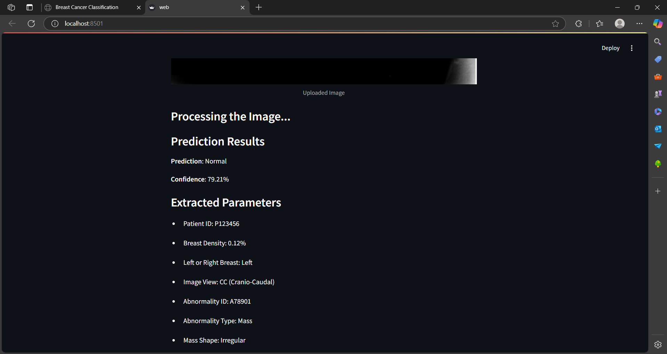
RESULTS

Slide 31
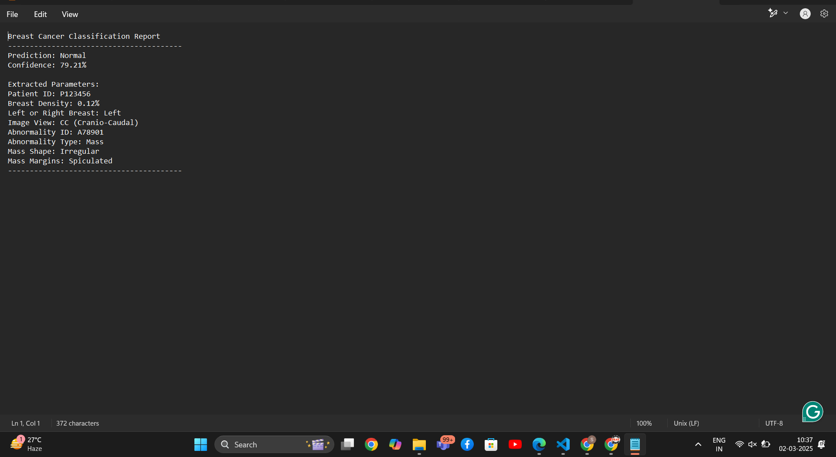
RESULTS

Slide 32
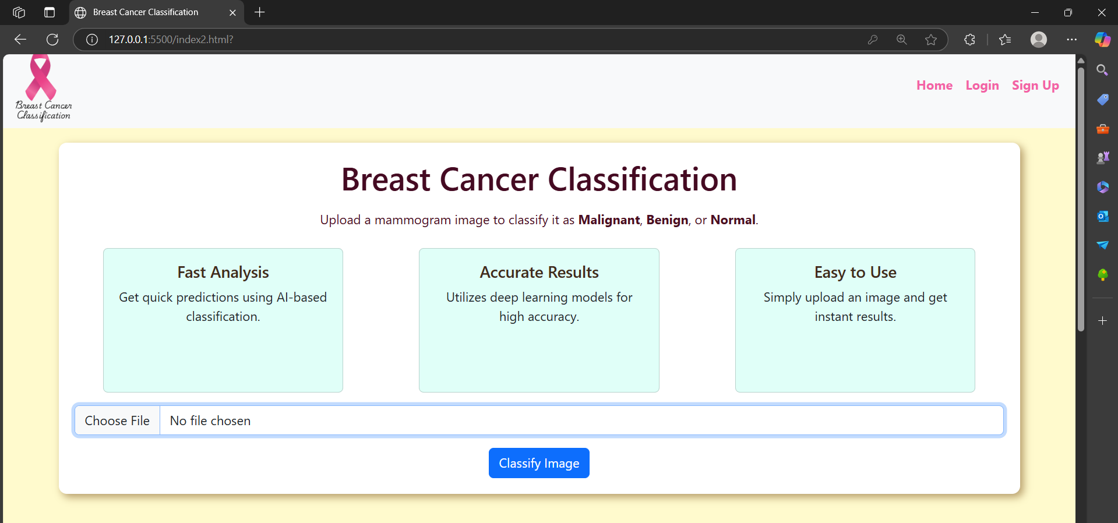
RESULTS

Slide 33
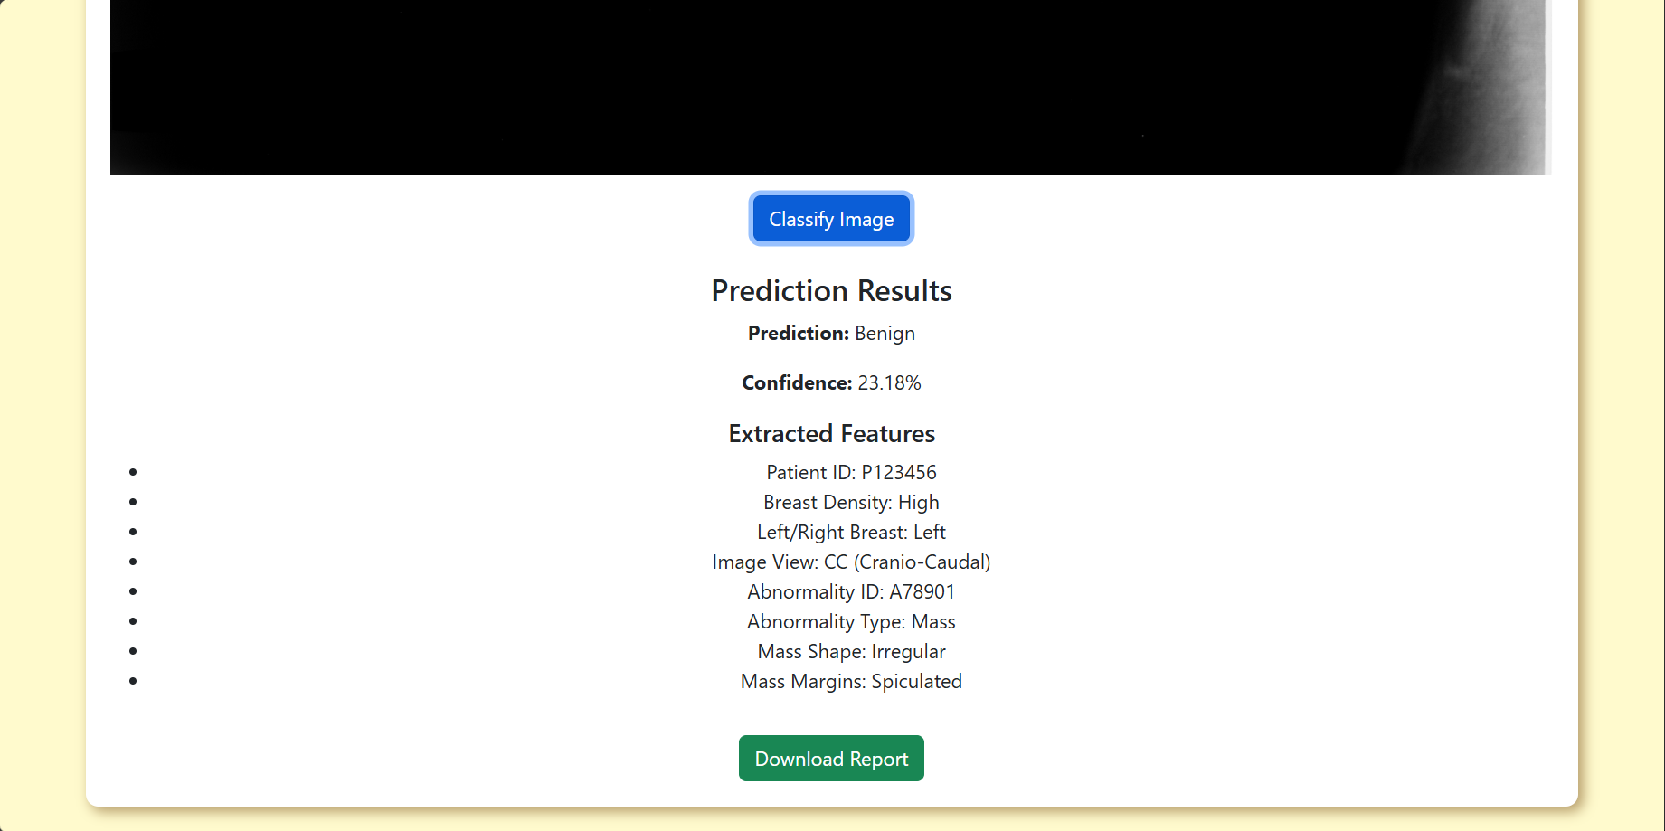
RESULTS

Slide 34
CONCLUSION
This project successfully compares the ResNet50, VGG16, and MobileNet deep learning models with an interactive Streamlit GUI for breast cancer classification. It provides an easy-to-use platform for healthcare professionals to accurately classify images as benign or malignant, supporting early detection and improved diagnostics. The use of cloud deployment ensures accessibility and scalability, making this AI-driven solution a valuable tool for enhancing breast cancer diagnosis and patient care.

Slide 35
PUBLICATION PLAN
Sr. No. | Target | Month and Year
1 | Publication (Review Paper) in Scopus/SCI Journal | 1st week of December
2 | Publication in Reputed IEEE/AIP /Web of Science Conferences if possible | 5th Week of January
3 | Publication of Research Paper in IEEE Transaction/SCI/ SCOPUS Index Journal | 2nd Week of February
4 | Patent 01 if possible | 2nd Week of February
5 | Copyright at least 01 | 4th Week of January

Slide 36
SUMMARY
S no | Point | Compliance
1 | Is research gap identified? | Yes
2 | Is the research question is in tune with research gap? | Yes
3 | Is the hypothesis in tune with the research question? | Yes
4 | Is the study design commensurate with the research question? | Yes
5 | Is the study feasible ? | Yes
6 | Whether the research lead to generation of new knowledge or achieve higher level of evidence? | Yes

Slide 37
REFERENCES
Amethiya, Yash, Prince Pipariya, Shlok Patel, and Manan Shah. "Comparative analysis of breast cancer detection using machine learning and biosensors." Intelligent Medicine 2, no. 2 (2022): 69-81.
Gupta, Vedika, Harshit Gaur, Srishti Vashishtha, Uttirna Das, Vivek Kumar Singh, and D. Jude Hemanth. "A fuzzy rule‐based system with decision tree for breast cancer detection." IET Image Processing 17, no. 7 (2023): 2083-2096.
Abarna, B., & Rajesh, S. (2022). Breast Cancer Detection by Using Supervised Learning Algorithm. Journal of Applied Information Science, 10(1), 29-33.
Sundaravadivelu, B., & Santhanakrishnan, K. (2023). Breast Cancer Detection Using Comprising Fuzzy C-Means and Artificial Bee Colony Optimization Segmentation and Grading with Random Forest Classifier. Traitement du Signal, 40(6).
Kriti, Virmani, J., & Agarwal, R. (2022). A characterization approach for the review of CAD systems designed for breast tumor classification using B-mode ultrasound images. Archives of Computational Methods in Engineering, 29(3), 1485-1523
Delphina, A. A., Kamarasan, M., & Sathiamoorthy, S. (2018). Image processing for identification of breast cancer: A literature survey. Asian Journal of Electrical Sciences, 7(2), 28-37.
Ensafi, M., Keyvanpour, M. R., & Shojaedini, S. V. (2024). ABT: a comparative analytical survey on Analysis of Breast Thermograms. Multimedia Tools and Applications, 83(18), 53293-53346.

Slide 38
THANK YOU

